Slide 1
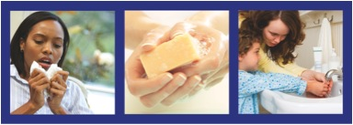
Protecting Yourself From Coronavirus in the Workplace
Safety and Health Awareness for
Responders to the Coronavirus
http://www.flu.gov/outreach/h1n1.html
March 2020
Notes:
This booklet is an awareness level resource for workers who might come in contact with COVID-19 virus (also called a type of coronavirus) in their places of work. This tool will help workers understand what the coronavirus is and how to protect against infection and other hazards related to the virus.
Trainers may use this tool to aid in development of an COVID-19 awareness level course or other awareness level materials. Workers involved in COVID-19 response actions will need additional and more advanced training.

Slide 2
Employer and worker responsibilities
Employers and workers have responsibilities under the OSH Act.
• The Occupational Safety and Health Act requires that employers provide a safe and healthful workplace free of recognized hazards and follow OSHA standards. Employers’ responsibilities also include providing training, medical examinations and recordkeeping.
• Workers must follow the employer’s safety and health rules and wear or use all required gear and equipment; follow safe work practices for your job, as directed by your employer; report hazardous conditions to a supervisor; and may report hazardous conditions to OSHA if employers do not fix them.
Notes:
Although there is no OSHA rule that deals specifically with the coronavirus, there are OSHA standards that cover a number of safety and health issues addressed in this booklet. Many of these OSHA standards, such as for respirators or hazard communication, include training requirements for workers. See Module 3 for some of those standards.

Slide 3
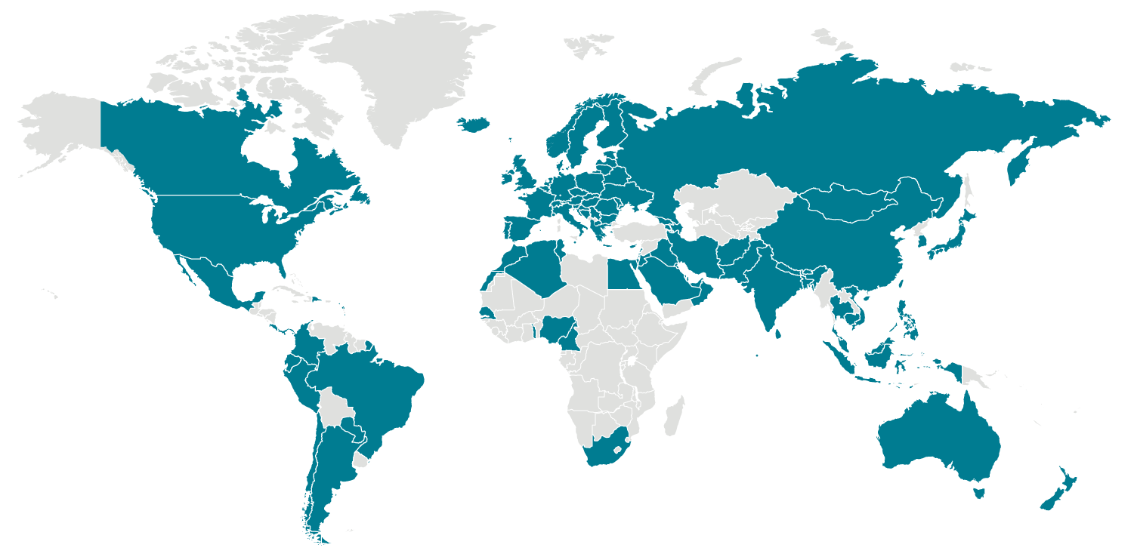
Locations with Confirmed COVID-19 Cases
Global Map
As of 12:00 p.m. ET March 10, 2020
Global case numbers are reported by the World Health Organization (WHO) in their coronavirus disease 2019 (COVID-19) situation reportexternal icon. For U.S. information, visit CDC’s COVID-19 in the U.S.
Notes:
According to the World Health Organization, as of March 9, 2020, there are more than 100,000 confirmed cases globally, reported in 102 countries/territories/areas. The countries with the highest number of cases include China (80,859), Korea (7,134), Italy (5,883), and Iran (5,823)
The WHO provides up to date information on the coronavirus: https://www.who.int/emergencies/diseases/novel-coronavirus-2019

Slide 4
How bad could it get?
That this disease has caused severe illness, including illness resulting in death is concerning, especially since it has also shown sustained person-to-person spread in several places.
These factors meet two of the criteria of a pandemic. As community spread is detected in more and more countries, the world moves closer toward meeting the third criteria, worldwide spread of the new virus.
Notes:
The 2009-H1N1 influenza is already responsible for significant morbidity and mortality worldwide since its appearance in the spring of 2009. While it is impossible to accurately predict the impact of the H1N1 virus in the future, the President’s Council of Advisors on Science and Technology (PCAST) reported in August that it was possible that the epidemic could:
• Produce infection of 30–50% of the U.S. population this fall and winter, with symptoms in approximately 20–40% of the population (60–120 million people). More than half of these people would seek medical attention.
• Lead to as many as 1.8 million U.S. hospital admissions during the epidemic, with up to 300,000 patients requiring care in intensive care units (ICUs). These very ill patients could occupy 50–100 percent of all ICU beds in affected regions of the country at the peak of the epidemic and could place enormous stress on ICU units, which normally operate close to capacity.
• Cause between 30,000 and 90,000 deaths in the United States, concentrated among children and young adults. By contrast, the 30,000–40,000 annual deaths typically associated with seasonal flu in the United States occur mainly among people over 65. As a result, 2009-H1N1 would lead to many more years of life lost.
• Pose especially high risks for pregnant women and people with neurological disorders, respiratory impairment, diabetes, or severe obesity.
The full Report can be viewed at:
http://www.whitehouse.gov/assets/documents/PCAST_H1N1_Report.pdf

Slide 5
Risk
For the majority of people, the immediate risk of being exposed to the virus that causes COVID-19 is thought to be low. There is not widespread circulation in most communities in the United States.
People in places where ongoing community spread of the virus that causes COVID-19 has been reported are at elevated risk of exposure, with increase in risk dependent on the location.
Healthcare workers caring for patients with COVID-19 are at elevated risk of exposure.
Close contacts of persons with COVID-19 also are at elevated risk of exposure.
Travelers returning from affected international locations where community spread is occurring also are at elevated risk of exposure, with increase in risk dependent on location.

Slide 6
What can we do?
BE informed
BE prepared
BE ready to adapt if:
  COVID-19 increases its ability to cause death and serious illness (virulence)
  COVID-19 becomes more wide spread
  There is a shortage of Personal Protective Equipment
Notes:
There are steps that workers and the rest of the general population can take to combat COVID-19:
Become and stay informed about the coronavirus and what can be done to reduce the chances of becoming infected. This booklet is intended to help workers understand what can be done in their workplaces to protect themselves. Other sources of information, including government websites and publications are aimed at the entire population.
Prepare by following the recommendations contained in this document and elsewhere.
The current situation is fluid. Information and public health officials’ guidance are subject to change, sometimes quite suddenly. There are many factors that could develop, which would require a revised strategy. Some of these developments could include:
- COVID-19 increases its ability to cause death and serious illness (virulence).
- COVID-19 becomes resistant to available treatments.
- There is a shortage of a safe and effective vaccine.
- Other prevention measures such as respirators are not available and/or effective.

Slide 7
The response to COVID-19 needs to be guided by the ‘precautionary principle’
When it comes to worker safety, we should be driven by the ‘precautionary principle’ that reasonable steps to reduce risk should not await scientific certainty about the nature of the hazard or risk.
Notes:
There is much that is not known about COVID-19. What is true today could change in the coming months. However, that does not mean that reasonable and effective steps cannot or should not be taken now to prepare and to protect workers. Erring on the side of caution will prevent illnesses and deaths.
The precautionary principle should guide our planning and actions: When it comes to worker safety, we should be driven by the ‘precautionary principle’ that reasonable steps to reduce risk should not await scientific certainty about the nature of the hazard or risk.

Slide 8

Module 1:
COVID-19 Basics

Slide 9
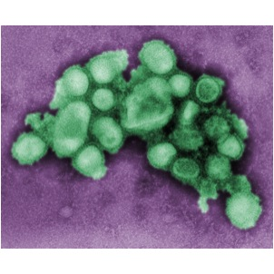
The coronavirus disease 2019 by the novel SARS-COV-2 virus
Novel - not seen before
Spreads easily
Little if any immunity in humans
Notes:
The virus has been named “SARS-CoV-2” and the disease it causes has been named “coronavirus disease 2019” (abbreviated “COVID-19”).
This virus was originally referred to as “swine flu” because laboratory testing at first showed that this new virus was very similar to influenza viruses that normally occur in pigs in North America. However, further study has shown that this new virus is very different from what normally circulates in North American pigs. It has two genes from flu viruses that normally circulate in pigs in Europe and Asia and bird (avian) genes and human genes. Scientists call this a "quadruple reassortant" virus.
Coronaviruses are a large family of viruses that are common in people and many different species of animals, including camels, cattle, cats, and bats. Rarely, animal coronaviruses can infect people and then spread between people such as with MERS-CoV, SARS-CoV, and now with this new virus (named SARS-CoV-2).
The SARS-CoV-2 virus is a betacoronavirus, like MERS-CoV and SARS-CoV. All three of these viruses have their origins in bats. The sequences from U.S. patients are similar to the one that China initially posted, suggesting a likely single, recent emergence of this virus from an animal reservoir. (https://www.cdc.gov/coronavirus/2019-nCoV/summary.html)
The virus is a novel strain, meaning that it is new or has not been seen in a very long time. As a result, humans have not developed natural immunity to COVID-19, and therefore could be infected.

Slide 10
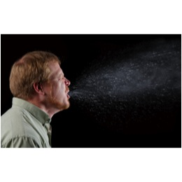
COVID-19 is spread from person to person mainly through coughing or sneezing
Contact -Touching something with COVID-19 virus on it and then touching mouth, nose or eyes
Droplet - respiratory secretions from coughing or sneezing landing on mucosal surfaces (nose, mouth, and eyes)
Airborne - Breathing in infectious COVID-19 particles
- Aerosol (under Droplet) a solid particle or liquid droplet suspended in air (or another gas), even temporarily.Cal/OSHA ATD standard.
Contagious 1 day before symptoms and for 5-7 days after onset
Notes:
Spread of COVID-19 virus is thought to occur in the same way that seasonal flu spreads. Flu viruses are spread mainly from person to person through coughing or sneezing by people with influenza.
Droplet transmission occurs when respiratory secretions from coughing or sneezing land on mucosal surfaces (nose, mouth, and eyes).
Contact transmission is touching something with COVID-19 virus on it and then touching your mouth, nose or eyes.
Airborne transmission means breathing in infectious COVID-19 particles.
People infected with H1N1 flu shed virus and may be able to infect others from 1 day before getting sick to 5 to 7 days after.
Most estimates of the incubation period for COVID-19 range from 1-14 days, most commonly around five days. The “incubation period” means the time between catching the virus and beginning to have symptoms of the disease.
This can be longer in some people, especially children and people with weakened immune systems and in people infected with the new COVID-19 virus.

Slide 11
COVID-19 causes familiar flu symptoms
Most common symptoms include:
Fever
Cough
Shortness of breath
Other symptoms may include:
Sore throat
Runny or stuffy nose
Body aches
Headache
Chills
Fatigue
Severe sicknesses and deaths have also resulted from illness associated with this virus.
Notes:
The following symptoms may appear 2-14 days after exposure

Slide 12
COVID-19 poses a greater risk for people with underlying health conditions
Heart disease
Lung disease
Diabetes
Asthma
Suppressed immune systems
Special population, such as pregnant women and children, at this time are not considered high risk of developing serious COVID-19 illness, but are at increased risk of severe illness from other infectious diseases.
Notes:
As is the case with seasonal flu, certain conditions appear to put some individuals at increased risk of complications associated with COVID-19. These underlying conditions are listed above.

Slide 13

Seasonal flu and COVID-19 are different
COVID-19 has the potential to cause more deaths and hospitalizations
COVID-19 has caused greater disease in older people and people with underlying health conditions
Notes:
At this time, H1N1 is expected to infect more people and cause more deaths and serious illnesses than seasonal influenza. On average, 36,000 people in the United States die from complications related to seasonal flu. Over 90% of deaths and about 60 percent of hospitalization normally occur in people older than 65.
H1N1 flu, by contrast, has caused greater disease in people younger than 25 years of age more than in older people. As this time, adults older than 64 years do not yet appear to be at increased risk of 2009 H1N1-related complications, which is unusual when compared with seasonal flu.
The immune systems of older individuals may be providing some protection. CDC laboratory studies have shown that no children and very few adults younger than 60 years old have existing antibody to 2009 H1N1 flu virus. However, about one-third of adults older than 60 may have antibodies against this virus. It is unknown how much, if any, protection may be afforded against 2009 H1N1 flu by any existing antibody.

Slide 14
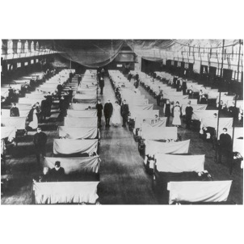
Pandemic influenzas have happened before and will likely could appear again
Three pandemics killed millions of people worldwide in the last century
1918 – between 40 and 100 million
1957 – 2 million
1968 – 1 million
Notes:
An influenza pandemic is a much more severe type of flu outbreak. Pandemic influenza occurs when a new strain of influenza virus appears, which causes serious illness in humans and is easily spread from person to person worldwide. The disease is very contagious because people have no immunity.
Past influenza pandemics have led to high levels of illness, death, social disruption, and economic loss. In the last century there were three such pandemics. The influenza outbreaks of 1918, 1957, and 1968 killed at least forty million, two million, and one million people worldwide, respectively.

Slide 15
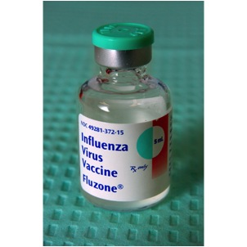
Vaccine ???
Vaccine currently does not exists to fight Covid-19, but it is being worked on.
Test kits are still being developed and distributed to identify Covid-19 infections
Notes:
While a vaccine is a central part of the effort to prevent infection and illness, other steps must be taken. Scientists have identified the H1N1 virus and have changed it in order to make and then test a new vaccine. The process, including producing millions of doses of vaccine, is followed each year to develop seasonal flu vaccine and takes months several months.
Unfortunately, influenza viruses, including H1N1, appear and start spreading before a vaccine is available. With a novel influenza virus, in this case H1N1, the population has little or no immunity to the virus.
Even when a vaccine is available, some people will not be vaccinated. Vaccines are tested to ensure that they are safe and effective for most people. However, vaccines normally can have side effects and present significant health risks for vulnerable individuals. Other people who are not considered to be at risk for serious reactions may choose not to receive the vaccine for various reasons.
There is also the possibility that the H1N1 virus could mutate, or change over time, which could reduce the vaccine’s ability to prevent infection.

Slide 16
Certain groups will be given priority for vaccination against H1N1
CDC's Advisory Committee on Immunization Practices (ACIP) recommends* the vaccine be given first to:
Pregnant women
Household contacts and caregivers for children younger than 6 months of age
Healthcare and emergency medical services personnel
All people from 6 months through 24 years of age
Persons aged 25 through 64 years who have health conditions associated with higher risk of medical complications from influenza
*http://www.cdc.gov/h1n1flu/vaccination/acip.htm
Notes:
CDC’s Advisory Committee on Immunization Practices (ACIP) recommended in July 2009 that certain groups be given priority to receive the novel H1N1 influenza vaccine once it becomes available this fall. They include:
Pregnant women because they are at higher risk of complications and can potentially provide protection to infants who cannot be vaccinated.
Household contacts and caregivers for children younger than 6 months of age because younger infants are at higher risk of influenza-related complications and cannot be vaccinated. Vaccination of those in close contact with infants less than 6 months old might help protect infants by “cocooning” them from the virus.
Healthcare and emergency medical services personnel because infections among healthcare workers have been reported and this can be a potential source of infection for vulnerable patients. Also, increased absenteeism in this population could reduce healthcare system capacity. Health care workers have a higher than average chance of exposure to H1N1.
All people from 6 months through 24 years of age.
This is based on many cases of novel H1N1 influenza among children from 6 months through 18 years of age because they are in close contact with each other in school and day care settings, which increases the likelihood of disease spread.
Many cases have been seen in otherwise healthy young adults 19 through 24 years of age who often live, work, and study in close proximity, and they are a frequently mobile population.
Persons aged 25 through 64 years who have health conditions associated with higher risk of medical complications from influenza.
The ACIP recommendations can be found at: http://www.cdc.gov/h1n1flu/vaccination/acip.htm

Slide 17

Module 2:
Assessing the Risk of Exposure to COVID-19 in the Workplace

Slide 18
The risk of exposure to COVID-19 at work is related to
Whether the type of setting you work in requires close proximity to people potentially infected with the coronavirus, and
Whether your specific job duties require you to have close, repeated or extended contact with known or suspected sources of coronavirus
Notes:
How can you determine if your risk for COVID-19 is greater where you work than in the general population? First, consider whether the type of setting you work in requires close proximity to people potentially infected with the COVID-19 virus. Next, ask whether your specific job duties require you to have either repeated, extended or close contact with known or suspected sources of the virus.
For example, a hospital is a work setting where there will be a greater concentration of individuals who have or are suspected of having the coronavirus.
However, employees who work in the same facility have different risks depending on what part of the institution they work in and the tasks that they perform. Staff who provide bedside care to a patient with COVID-19 have a higher risk of becoming infected at work than someone working in the billing office.

Slide 19
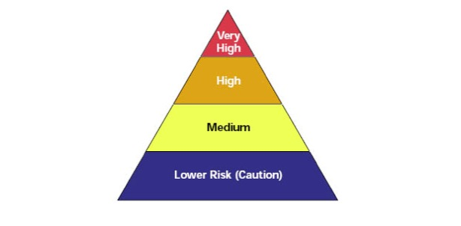
OSHA has classified workplaces into four categories of risk for pandemic influenza
http://www.osha.gov/Publications/influenza_pandemic.html
Notes:
In its Guidance on Preparing Workplaces for an Influenza Pandemic, the Occupational Safety and Health Administration (OSHA) has developed an occupational risk pyramid for pandemic influenza to help categorize potential exposures in workplaces. OSHA presents four groups of employee risks of occupational exposure to influenza during a pandemic, ranging from very high to high, medium, or lower (caution) risk. OSHA’s risk categories and guidance on response actions are based on a more severe pandemic, not the current H1N1 situation. However, since the H1N1 pandemic could become much worse, workplaces should have contingency plans to address a more severe H1N1 outbreak.
The document can be accessed at: http://www.osha.gov/Publications/influenzapandemic.html

Slide 20
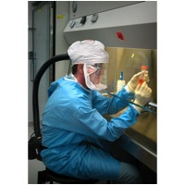
Very High exposure risk occupations are those with high potential exposure to high concentrations of known or suspected sources of COVID-19 during specific medical or laboratory procedures
Examples of work settings
health care
laboratories
autopsy suites
Examples of job activities
bronchoscopy
sputum induction
working with specimens in laboratories
some dental procedures
some autopsy procedures
Notes:
Very High exposure risk occupations are those with high potential exposure to high concentrations of known or suspected sources of COVID-19 during specific medical or laboratory procedures. High concentrations of coronavirus could result from activities that generate aerosols from known or suspected sources. An aerosol is a spray or mist that is made up of solid or liquid particles.
Examples of work procedures that can produce aerosols that could contain COVID-19 or other coronavirus particles include:
Bronchoscopy
Sputum induction
Working with specimens in laboratories
Some dental procedures
Some autopsy procedures
Keep in mind that the very high risk category only applies to staff who are close to the coronavirus source while the aerosol is present.

Slide 21
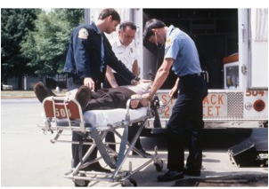
High Exposure risk occupations have a high potential for exposure to known or suspected sources of coronavirus
Examples of work settings
hospitals and other types of health care facilities
medical transport
correctional facilities
drug treatment centers
homeless shelters
home health care
Examples of job activities
direct patient care
emergency medical services
housekeeping and maintenance in patient areas
Notes:
High exposure risk occupations are those with high potential for exposure to known or suspected sources of coronavirus.
Jobs that fall into this category include:
Healthcare delivery and support staff who are exposed to known or suspected COVID-10 patients (for example, doctors, nurses, and other hospital staff that must enter patients' rooms).
Medical transport of known or suspected patients in enclosed vehicles, such as emergency medical technicians.
Job duties considered at high risk for COVID-19 could take place outside of a healthcare facility. For example, staff who treat inmates with or suspected of having COVID-19 within a prison health setting would have a risk similar to those caring for patients in a hospital. If the correctional facility refers sick inmates to another facility, staff involved in transporting the prisoners would be performing a medical transport function.

Slide 22

Medium risk jobs involve high-frequency contact with the general population
Examples of work settings
schools
outpatient health care
social services
high density of coworkers
high volume retail or other contact with the general public
Examples of job activities
classroom instruction
aiding clients
serving customers
Notes:
A medium risk refers to settings where workers have high-frequency contact with the general population in settings such as schools, outpatient health care, social services, high density of coworkers and high volume retail.

Slide 23
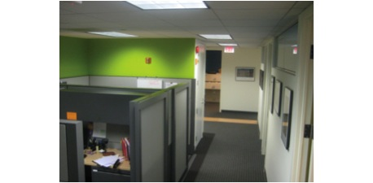
Lower exposure risk occupations are those that do not require contact with people known to be infected, nor frequent contact with the public
Notes:
Lower exposure risk (caution) occupations are those that do not require contact with people known to be infected with the coronavirus, nor frequent close contact with the public, for example office workers or construction workers.

Slide 24
The level of risk to employees in a health care or other type of facility depends on their exposure to known or suspected sources of COVID-19 resulting from their job duties
Setting Job Activities
Minimal contact with public
(office)
High frequency contact with general public but not to known or suspected source (cafeteria)
Provide care to known or suspected patients (bedside care)
Perform or present during procedures that produce aerosols
(bronchoscopy, sputum induction)
Health care
Notes:
Not everyone in a very high risk setting is at very high risk of being exposed to COVID-19. Workers’ level of risk depends on whether or not they are performing aerosol generating procedures or are in the same area when these activities are taking place. Only certain workers in a hospital, for example would fall into the very high or high risk categories.
For example, hospital staff who are present where procedures that generate aerosols, such as bronchoscopy or sputum induction, on known or suspected COVID-19 cases are at the highest risk. Medical staff who provide bedside care and other employees who enter rooms of patients known or suspected of being infected are at high risk. Other employees, such as kitchen staff or those who work in the billing office have a lower risk.

Slide 25
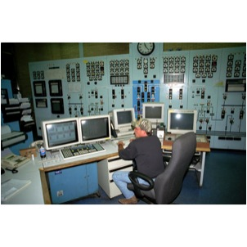
Emergency services and critical infrastructure must be able to function during a pandemic
Emergency services and critical infrastructure include:
law enforcement
emergency response
public utilities
Notes:
Critical infrastructure and key resource operations include law enforcement, emergency response, or public utility employees. Although these types of workers’ potential exposure to COVID-19 does not generally fall into a high category, it is prudent to consider upgrading protective measures for these employees beyond what would be suggested by their exposure risk. The extra caution is based on the necessity of such services for the functioning of society as well as the potential difficulties in replacing them during a pandemic (for example, due to extensive training or licensing requirements).

Slide 26
Keeping critical infrastructure and key resources operating is a priority
Government Facilities
Dams
Commercial Facilities
Nuclear Power Plants
Critical Infrastructure
Food and Agriculture
Public Health and Healthcare
Banking and Finance
Chemical and Hazardous Materials
Defense Industrial Base
Water
Energy
Emergency Services
Information Technology
Telecommunications
Postal and Shipping
Transportation
National Monuments and Icons
Notes:
The U.S. government has placed a special emphasis on supporting pandemic influenza planning for public and private sector businesses deemed to be critical industries and key resources (CI/KR). Critical infrastructure are the sectors that provide the production of essential goods and services, interconnectedness and operability, public safety, and security that contribute to a strong national defense and thriving economy. Key resources are facilities, sites, and groups of organized people whose destruction could cause large-scale injury, death, or destruction of property and/or profoundly damage our national prestige and confidence.
Key ResourcesGovernment FacilitiesDamsCommercial FacilitiesNuclear Power PlantsCritical InfrastructureFood and AgriculturePublic Health and HealthcareBanking and FinanceChemical and Hazardous MaterialsDefense Industrial BaseWaterEnergyEmergency ServicesInformation TechnologyTelecommunicationsPostal and ShippingTransportationNational Monuments and Icons
Additional guidance for CI/KR business is available at:
www.pandemicflu.gov/plan/pdf/CIKRpandemicInfluenzaGuide.pdf.

Slide 27
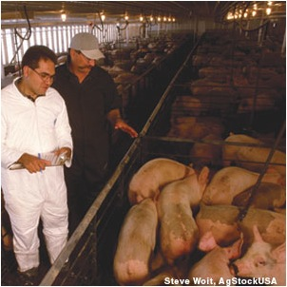
Delete pageContact with swine does not pose a serious threat of H1N1 in people at this time
H1N1 could spread in the future through contact with infected pigs or environments contaminated with H1N1 flu virus
Cannot catch H1N1 from eating pork
Notes:
Pigs do not currently pose a serious threat to humans. HIN1 can spread through contact with infected pigs or environments contaminated with H1N1 flu virus.
You cannot catch H1N1 from eating pork.

Slide 28
Delete page Pigs can get swine flu
Signs of flu in pigs can include any of the following:
sudden onset of fever
lethargy, lack of alertness
going off feed (poor appetite)
coughing (barking)
discharge from the nose or eyes, eye redness or inflammation
sneezing
breathing difficulties
Notes:
Flu viruses are thought to spread from infected people and pigs to other people and pigs mostly through coughing or sneezing, and through contact with surfaces contaminated by flu viruses. To prevent flu viruses from spreading between people and pigs, it is important for people working with pigs to recognize the signs of flu in pigs. Typically a combination of signs will occur together in infected pigs.
Signs of flu in pigs can include any of the following:
sudden onset of fever
lethargy, lack of alertness
going off feed (poor appetite)
coughing (barking)
discharge from the nose or eyes, eye redness or inflammation
sneezing
breathing difficulties
If a pig is showing these signs, even mildly, you should call your veterinarian. Do not allow sick pigs to enter your farm or facility and do not move sick pigs off your property.

Slide 29
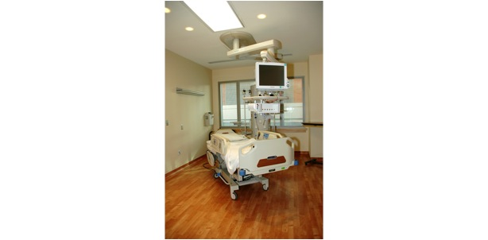
Module 3:
Methods to Prevent COVID-19
Exposure in the Workplace

Slide 30
Basic hygiene and social distancing steps that apply to every workplace
Stay home when sick
Wash hands or use sanitizer frequently
Avoid touching your nose, mouth & eyes
Cover coughs & sneezes with tissues or sleeve
Dispose of tissues in no-touch bins
Wash hands or use sanitizer after coughing, sneezing or blowing nose
Avoid close contact with coworkers and customers
Avoid shaking hands/wash hands after physical contact with others
Notes:
Regardless of risk category, there are a number of steps that everyone can take to lower the chances of becoming sick or spreading COVID-19 at work.
Stay home if you are sick.
Wash your hands frequently with soap and water for 20 seconds or use hand sanitizer if soap and water are not available.
Avoid touching your nose, mouth and eyes.
Cover your coughs and sneezes with a tissue, or cough and sneeze into your upper sleeve.
Dispose of tissues in no-touch trash receptacles.
Wash your hands or use a hand sanitizer after coughing, sneezing, or blowing your nose.
Avoid close contact with coworkers and customers.
Avoid shaking hands and always wash your hands after physical contact with others.

Slide 31
Basic hygiene and social distancing steps that apply to every workplace
(continued)
If wearing gloves, wash hands after removing
Keep common surfaces (such as telephones, keyboards, etc) clean
Avoid using other workers’ equipment if possible
Minimize group meetings by using phone, email, etc., and avoid close contact when meetings are necessary
Limit unnecessary visitors to the workplace
Maintain your physical and emotional health with rest, diet, exercise and relaxation

Slide 32
COVID-19 planning should be integrated into an existing safety and health system
Management leadership and employee participation
Hazard identification and assessment
Hazard prevention and control
Education and training
System evaluation and improvement
Plan for a pandemic with “increased severity”
  CDC recommends planning for current severity and “increasing severity”
Notes:
Planning and preparation for COVID-19 should be integrated into existing safety and health systems. Elements of an effective program include, but are not limited to those listed above.
Maintain flexibility so the COVID-19 plan can be modified in the event of a pandemic with “increased severity.”

Slide 33
Use methods that protect workers, starting with the most effective
Work practices
Administrative controls
Personal protective equipment
Engineering controls
Notes:
As with most any hazard, there are a variety of steps that can reduce or in some cases even eliminate workers’ exposure. A basic principle of workplace safety is to use a combination of strategies to protect workers, starting with the most effective. This approach of moving from most effective to least effective protective measures is called the ‘hierarchy of controls.’
The order of controls, from most effective to least effective is:
Engineering controls
Work practices
Administrative controls and
Personal protective equipment

Slide 34
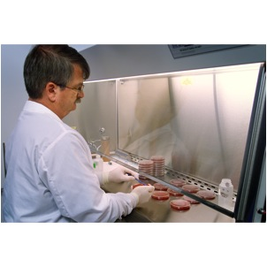
Engineering controls include
Ventilation
Drive through service
Plastic shields and other barriers
Notes:
Engineering controls involve making changes to the work environment to reduce work-related hazards. These types of controls are preferred over others because they make permanent changes that reduce exposure to hazards and do not rely on worker or customer behavior. By reducing a hazard in the workplace, engineering controls are not only the most effective, but can also be the most cost-effective solutions for employers to implement.
Examples of engineering controls include:
Using specialized ventilation to remove hazards from the air.
Installing physical barriers, such as clear plastic sneeze guards.
Installing a drive-through window for customer service.

Slide 35
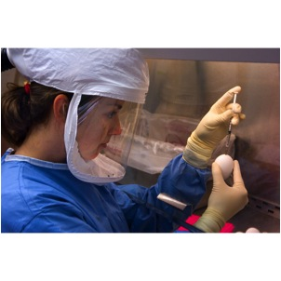
Engineering Controls for Very High and High-risk Jobs
Engineering controls for very high and high risk workers include:
negative pressure isolation rooms
biological safety cabinets
Notes:
Engineering controls protect workers by removing or reducing COVID-19 from the work environment. Negative pressure ventilation is an engineering control that is used staff conduct procedures that create aerosols or enter patient rooms of known or suspected COVID-19 cases.
In the photograph above, a microbiologist is conducting an experiment inside a biological safety cabinet (BSC). The airflow within the BSC helps prevent any airborne virus from escaping the confines of the cabinet. As added protection, she is wearing a powered air purifying respirator (PAPR).

Slide 36
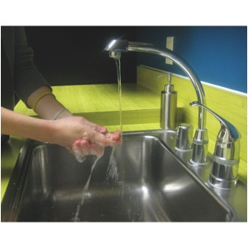
Work practices and administrative practices can reduce workers’ exposures
Work practices to reduce COVID-19 exposure include:
hand washing/sanitizer
no-touch trash cans
cough/sneeze etiquette
limiting the number of staff present for very high or high risk tasks
training
Notes:
Work practices and administrative procedures are used to reduce the length, frequency or intensity of exposure to a hazard. Employers should:
Provide resources and a work environment that promotes personal hygiene. For example, supply tissues, no-touch trash cans, hand soap, hand sanitizer, disinfectants and disposable towels for workers to clean their work surfaces.
Develop procedures to minimize contacts between workers and between workers and patients, clients or customers.
Limit the number of staff present for very high or high risk tasks, such as aerosol generating procedures or entering patient room.
Provide workers with up-to-date education and training on coronavirus risk factors, and methods to prevent exposure.

Slide 37

Adjust policies to reduce exposures
Policies that can help to reduce exposure to COVID-19 include:
Encouraging workers who are ill to stay home without fear of reprisals or loss of pay or benefits
Using email, phone, teleconferences instead of face-to-face contact
Notes:
Adjustments in workplace policies can also reduce exposures.
Encouraging ill workers to stay at home without fear of any reprisals.
Discontinuing nonessential travel to locations having high prevalence of illness.
Using e-mail, websites and teleconferences to minimizing face-to-face contact between workers. Where possible, encourage flexible work arrangements such as telecommuting or flexible work hours to reduce the number of workers who must be at the work site at one time or in one specific location.
Relying on home delivery of goods and services to reduce the number of clients or customers who must visit your workplace.
Developing emergency communications plans. Maintain a forum for answering workers' concerns and develop Internet-based communications, if feasible.
Provide education and training materials in an easy to understand format and in the appropriate language and literacy level for all employees.

Slide 38

Personal protective equipment (PPE) includes
Gloves
Face shields
Respirators
Protective clothing
Notes:
Personal Protective Equipment (PPE) is gear that workers wear or use to reduce their exposures to hazards. If used correctly, PPE can help prevent some exposures; however, they should not take the place of other prevention interventions, such as engineering controls, cough etiquette and hand hygiene.
Examples of PPE include:
respirators
face shields
goggles
gloves
There are many factors involved with the proper use of PPE:
The type of PPE that is used must be selected based upon the hazard to the worker.
Some PPE, like respirators, must fit properly and be worn correctly.
PPE must be maintained and replaced in accordance with manufacturer's specifications.
PPE that is not reused must be properly removed and disposed of to avoid contaminating the worker, co-workers or the environment.
Reusable PPE must be properly removed, cleaned, disinfected and stored.

Slide 39
The use of personal protective equipment must comply with OSHA Standards
OSHA Standard 1910.132 has general requirements that employers must follow for PPE:
Assess workplace for hazards that require the use of PPE
Select the correct type of PPP for the hazards
Ensure that PPE fits each wearer
Notes:
OSHA has general requirements that must be followed whenever personal protective equipment is needed to protect workers. All PPE must be of a safe design for the work that is to be performed. Before any PPE is chosen, the employer must conduct a hazard assessment of the workplace to identify existing and potential hazards that require the use of PPE. The employer must then select and have each affected employee use the PPE to protect against the hazards that have been identified.
OSHA Standard 1910.132 spells out general requirements on the use of PPE.

Slide 40
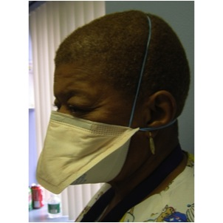
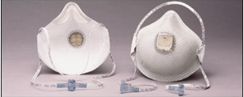
Respirators are needed when there is a risk of airborne transmission
A N95 respirator is the
minimum level of
protection to prevent
inhaling COVID-19
Notes:
Respirators are used to prevent breathing in hazards that are in the air. Respirators protect the wearer by either filtering the air before it is inhaled by the worker, or by supplying air from a safe source. Most respirators that protect the worker by filtering the air are designed to fit tightly against the face, and thereby provide a seal between the respirator's edge and the face. When there is a proper seal, the air the worker breathes passes through the respirator’s filter, which captures contaminants. If there is not a tight seal, the air passes through the gaps between the face and the respirator and contaminants are not filtered from the air that the worker breathes.

Slide 41
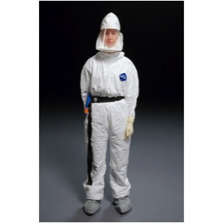
There are reusable respirators that provide greater protection than disposal respirators
Powered air-purifying respirator (PAPR)
Half or full-face elastomeric respirators
Notes:
There are many types of respirators that are designed to be reused and that provide a much higher degree of protection than disposable respirators against airborne hazards. A half-face or full-face air-purifying respirator provides a tighter fit and has more effective air filtration than N-95 respirators.
Powered air purifying respirators can be either tight-fitting or loose fitting depending on the design. In either case, air is drawn in by a pump and travels through a hose. The air passes through a filter before being blown across the worker’s face.

Slide 42
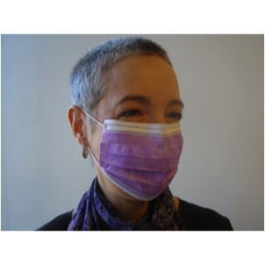
Surgical masks are not respirators
Surgical masks do not:
Fit tightly against the skin to form a seal
Filter tiny particles, such as viruses or bacteria that are in the air
Notes:
Surgical masks are not respirators. Surgical masks are not designed or certified to prevent the the wearer from inhaling small airborne hazards, such as viruses, or virus particles. Surgical or procedure masks do not form a tight seal against the user's face. Therefore, when the wearer breathes in, much of the potentially infectious air passes through gaps between the face and the surgical mask. Second, many surgical masks are not made of a material that can filter microscopic particles. Only surgical masks that are cleared by the U.S. Food and Drug Administration and legally marketed in the United States have been tested for their ability to resist blood and body fluids can be used.
Surgical masks are used as a physical barrier to protect employees from hazards such as splashes of large droplets of blood or body fluids. Surgical masks also prevent contamination by trapping large particles of body fluids that may contain bacteria or viruses when they are expelled when the wearer coughs and sneezes.
Surgical/procedure masks are used for several different purposes, including:
Being placed on sick people to limit the spread of infectious respiratory secretions to others.
Worn by healthcare providers to prevent accidental contamination of patients' wounds by the organisms normally present in mucus and saliva
Worn by employees to protect themselves from splashes or sprays of blood or body fluids; they may also have the effect of keeping contaminated fingers/hands away from the mouth and nose.

Slide 43
Respiratory protection must comply with all elements of OSHA Standard 1910.134
Written program
Selection hazard to match hazard
Medically fit to wear
Fit testing
Ensure proper use of respirators
Respirator maintenance
Labeling/color coding filters
Employee training
Program evaluation
Recordkeeping
Notes:
Respirators must be used according to OSHA’s Standard 1910.134. OSHA requires that employers:
Have a written program with worksite specific procedures.
Select respirators based on the hazards in the workplace.
Provide a medical evaluation to determine the employee’s ability to wear a respirator.
Fit test respirators that require a tight seal between the worker’s face and the respirator.
Establish and implement procedures for the proper use of respirators.
Provide for cleaning, storage, and repair of respirators.
Ensure that all filters, cartridges and canisters are labeled and color coded.
Train workers at least once a year on the proper use and limitations of respirators.
Conduct an evaluation to make sure the respiratory program is being properly implemented.
Keep records on medical evaluations, fit testing and other aspects of the program.

Slide 44
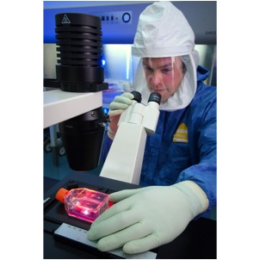
Personal protective equipment for
Very High and High risk jobs include:
Face/eye protection
Gloves
Gowns
Respirators
  at least N95
  PAPR or full face elastomeric for greater protection
Notes:
Personal protective equipment protects against exposures to COVID-19 that cannot be eliminated or reduced by other measures. Workers need to use gloves, gowns, and face/eye protection.
Respirators approved by the National Institute for Occupational Safety and Health (NIOSH) are needed to prevent inhaling airborne COVID-19 particles. At a minimum, workers need to wear an N95 respirator. A higher level of respiratory protection, such as a powered air-purifying respirator or PAPR, should be worn during procedures that generate aerosols.
Filters and masks have an expiration date on the packaging or device and should not be used after the expiration date. Maintaining equipment that is current (not expired) should be part of the practices and procedures in the workplace.

Slide 45

Other OSHA standards apply to
COVID-19 response actions
Notes:
Although there is no specific OSHA standard for COVID-19 standard or other infectious diseases that spread through the air, there are other OSHA regulations that apply to coronavirus response actions.

Slide 46
The hazard communication standard (1910.1200) is a worker’s right to know about chemicals
OSHA’s Hazard Communication Standard (1910.1200) requires:
list of all hazardous chemicals in the workplace
labels on containers
chemical information sheets (material safety data sheets)
training
written program on how to inform workers
Notes:
Workers who use chemicals for cleaning and disinfection must understand the hazards of using these substances. OSHA’s Hazard Communication Standard, 1910.1200, requires employers to:
Maintain a list of all hazardous chemicals in the workplace.
Ensure all chemical containers are labeled.
Obtain and make available chemical information sheets (material safety data sheets) for all hazardous chemicals in the workplace.
Provide training to workers on hazardous chemicals, and
Develop and implement a written program on how to inform workers of hazardous chemicals in each of their workplaces.

Slide 47
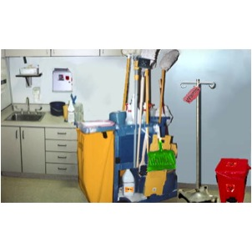
Portable containers must usually be labeled
Exception: portable containers do not have to be labeled if only the worker who transfers the chemical uses it during that shift
Notes:
Portable containers usually have to be labeled. Employers are not required to label portable containers when a worker transfers a chemical from a labeled container as long as only that employee will use the portable container during his or her shift.

Slide 48
OSHA’s Bloodborne Pathogens Standard (1910.1030) prevents other infections
Bloodborne pathogens means diseases that are spread through contact with blood and other body fluids containing blood
Bloodborne illnesses include, but are not limited to:
  HIV/AIDS
  Hepatitis B
  Hepatitis C
Notes:
OSHA’s Bloodborne Pathogens Standard, 1910.1030, contains requirements to prevent workers’ exposure to illnesses that are spread through contact with blood and other body fluids containing blood.

Slide 49
The Bloodborne Pathogens Standard requires measures to prevent exposure to blood and body fluids
Treat all blood and fluids that might contain blood as infectious – ‘standard precautions’
Use safety needles and sharps to prevent cuts
Put all used needles and sharps in sharps containers
Provide hepatitis B vaccination
Use gloves, face shields and other PPE
Record needlesticks and sharps injuries
Notes:
The Bloodborne Pathogens Standard requires measures to prevent exposure to blood and body fluids:
All blood and body fluids that might contain blood are to be considered infectious. Treating all blood and other body fluids as potentially infectious is known as standard precautions.
The use of safety needles and other sharp instruments that are designed to prevent needlesticks and cuts.
After use, all needles and sharps must be placed in a sharps container.
Workers with occupational exposure to blood must be provided with hepatitis B vaccination.
Gloves, face shields and other PPE must be used to prevent contact with blood and body fluids.
Employers must record needlesticks and other sharps injuries on a separate place called a sharps injuries log.
The standard also includes requirements for training, procedures to follow if there has been an exposure to blood, preventing exposure in laboratories, and other provisions.

Slide 50
California OSHA issued an Aerosol
Transmission Disease (ATD) Standard http://www.dir.ca.gov/Title8/5199.html
The standard applies to many types of health care settings, facilities receiving persons from uncontrolled releases of hazardous substances, police services, correctional facilities, drug rehab centers, homeless shelters, and other settings
The standard requires different types of engineering controls, work practices and administrative controls, and PPE depending on the level of exposure risk
Notes:
California’s State OSHA program issued an Aerosol Transmission Disease Standard (ATD) in the summer of 2009. While it only applies to certain workplaces in California, it is a very good model of precautions that should be taken elsewhere.
California’s ATD Standard applies to health care settings such as hospitals, skilled nursing facilities, clinics, medical offices, and other outpatient medical facilities, long term health care facilities and hospices, and medical outreach services. It also covers paramedic and emergency medical services including these services when provided by firefighters and other emergency responders and medical transport. The standard also applies to facilities that are designated to receive persons arriving from the scene of an uncontrolled release of hazardous substances, police services, correctional facilities, drug rehabilitation centers, homeless shelters and other settings.
The standard requires a variety of engineering controls, work practices and administrative controls, and personal protective equipment depending on the nature of the exposure risk.

Slide 51
Acronyms
CDC Centers for Disease Control and Prevention
EPA U.S. Environmental Protection Agency
HEPA high-efficiency particulate air
HHS U.S. Department of Health and Human Services
JCAHO Joint Commission on Accreditation of Healthcare Organizations
LRN Laboratory Response Network
NIOSH National Institute for Occupational Safety and Health
OSH Act Occupational Safety and Health Act of 1970
OSHA Occupational Safety and Health Administration
PAPR powered air-purifying respirator
PPE personal protective equipment
SNS Strategic National Stockpile
WHO World Health Organization

Slide 52
For more information go to
Centers for Disease Control and Prevention (CDC)
http://www.cdc.gov
Occupational Safety and Health Administration (OSHA)
http://www.osha.gov
World Health Organization
http://www.who.int/en/
National Institute for Occupational Safety and Health (NIOSH)
http://www.cdc.gov/NIOSH/

Slide 53
Why this training tool was created
This training tool was created by the NIEHS National Clearinghouse for Worker Safety and Health Training under a contract (273-05-C-0017) from the National Institute of Environmental Health Sciences Worker Education and Training Program (WETP). WETP has trained over a million emergency responders and hazardous waste workers since 1987 to do their jobs safely. WETP is a part of the Department of Health and Human Services, which is a cooperating agency under the Worker Safety and Health Support Annex of the National Response Plan. As part of the coordinated effort, the National Clearinghouse worked with NIEHS, WETP to create this orientation briefing for those who may be exposed to H1N1 (swine flu).
Notes:
For more information, contact the National Clearinghouse for Worker Safety and Health Training at http://tools.niehs.nih.gov/wetp/, 202-331-7733, or info@wetp.org.

