Slide 1

Virgin Islands Department of Labor
Proposed Change in VI Unemployment Insurance Experience Rating System
Presented by VIDOL Office of the Commissioner
Copyright 2019
Notes:
______________________________________________________

Slide 2
Why the need for the proposed legislation?
Three main objectives we seek with the proposed legislation are:
  Federal Compliance
  Trust Fund Reserve
  Simplification
Notes:
The Current law has not generated sufficient funds to keep the Trust fund solvent. This has lead to higher taxes for the private sector.

Slide 3
Federal Compliance
  With this change VIDOL will be in conformity and compliance with Federal Law.
Notes:
By being in compliance with Federal mandates, we will be able to utilize the FUTA waiver
_owe on the loan and do not adequately use the experience rating

Slide 4
Trust Fund Reserve
  Provide an adequate level of trust fund reserve for the long term.
Notes:
One of the most important goals is to have a Trust fund reserve that is able to support future Virgin Islanders.

Slide 5
Simplification
  VIDOL will have a simplified methodology to administer.
    Lower costs and greater efficiency.
Notes:
The current methodology is arduous to administer for the staff. The brackets will be clearly delineated on a yearly basis from the formula we will discuss below. With the proposed method the cost will be easy to calculate.
Currently there are three factors that must be considered to calculate a single tax payer contribution: wages, benefit charge back and the credits vs. wages under the proposed system.

Slide 6
How did we get here?
2001- Trust fund balance was solvent.
2001 -Tax cut enacted by Virgin Islands legislature reduced revenue into the Trust Fund. Reducing the ability to pay future benefits.
2002-2008: The funds were adequate to cover claims, however there were consistent benefit charges and the reserves diminished.
2007- Economic recession further eroded the fund balance.
2009- Virgin Islands began to borrow to cover benefits.
2002-2012- There were no employer contributions.
2012- Hovensa closure resulted in over 3000 additional claims.
2014- We borrowed 86 million in from the Federal government.
2017- Hurricanes Irma and Maria.

Slide 7
Average Tax Rate Benefit Cost Rate Trust Fund Reserve

Slide 8
Law prior to 2001
Reserve Ratio:
Reserve = contribution amount an employer pays into the fund +benefits amount paid to the employee when terminated during 3 years.
Wages = wages paid for three years (same period)
Formula: Reserve ratio= Current Reserve/Total Wages
Notes:
The Current Reserve calculation uses the past three years of benefit and contribution history in the formulation
(the difference between contribution paid and benefits charged in and employers experience rating account during a 12 quarter/3 year period) (divided by total wages paid for the same period) =reserve ratio
Formula: Current Reserve/Total Wages=Reserve ratio

Slide 9
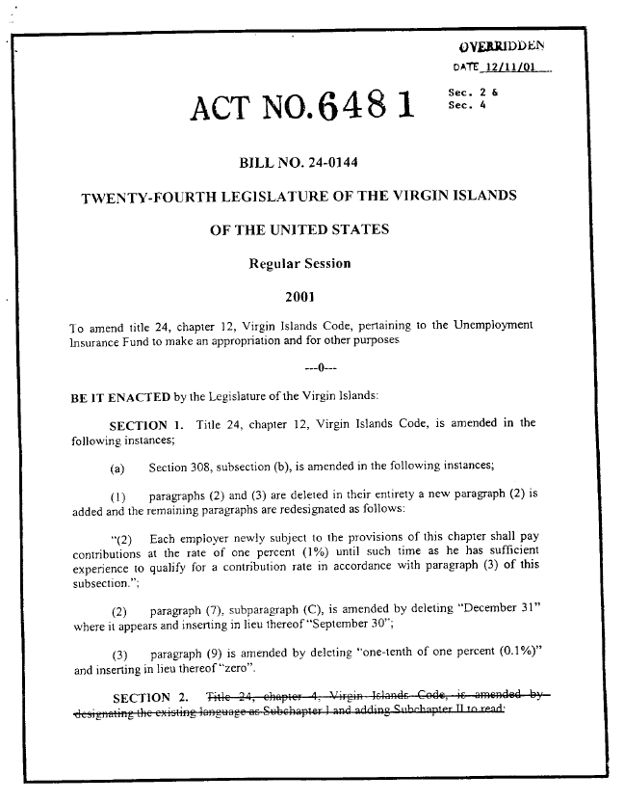
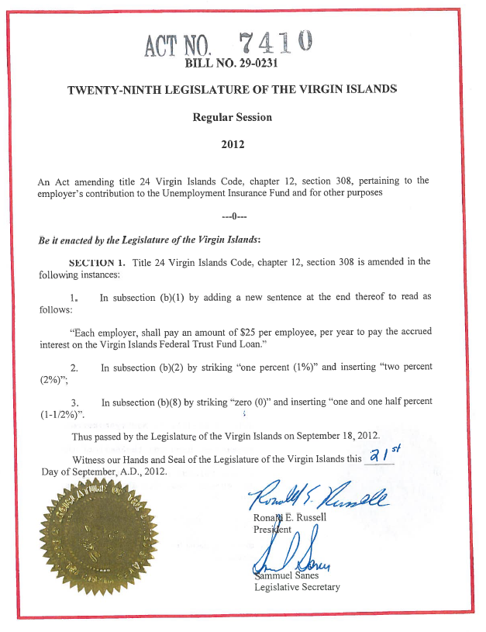
Flat Tax Rate

Slide 10
Proposed System-Payroll Variation index
Payroll Variation Index = ((sum of positive Payroll Change Percentages) + (2 x (sum of negative Payroll Change Percentages)) / 12
Notes:
Payroll Variation is a system whereby employers are taxed at lower contribution rates when their payroll is increased and higher tax contribution rates when its decreased, and includes a feature to reward those employers who do not frequently utilize the UI system.
Index:
is based on calculating a payroll change percentage for each quarter over a three-year period and averaging those quarterly changes over the whole time period. For seasonal employment payroll fluctuations a greater weight will be assigned to payroll decreases -- payroll reductions will be given twice the weight of payroll increases to ensure that the utilization of the Unemployment system, compared to employers whose payroll stays constant, is reflected in the calculation

Slide 11
What is the Virgin Islands Trust Fund Balance?
-$63,480,034.01 (as of July 26, 2019)
Based on the current loan structure the VI expects to payoff the loan by 2025.
With the proposed change in the law the Trust fund will be paid off by 2024.
https://oui.doleta.gov/unemploy/budget.asp

Slide 12
FUTA: Federal Unemployment Tax Act
The FUTA tax is calculated by:
The Federal offset credit is 90.0% of the Federal Base Tax.
  6.0% x 90.0%= 5.4%
  Employers receive a 5.4% credit against the tax if have no federal UI loan and in compliance with all of the federal statutes.
  Base Federal Unemployment Tax Rate: 6.0% on the first $7,000 of employees’ earnings.
  The total federal employment tax would be reduced by the credit as follows:
  Total Federal Tax : 6.0%
  Offset credit -5.4%
  Net Federal Tax 0.6%
Currently due to the outstanding loan the 2019 FUTA tax rate will be 3.3%
Notes:
The BCR is the Base Credit Reduction that can add and additional penalty to that the tax can be upwards of 9%.
5.

Slide 13
How do we finance the fund?
The Unemployment Insurance system uses a contribution rate to establish the overall funding levels necessary (taxes) to cover an adequate level of benefits for the entire system.
In addition to the contribution rate, employers are also graded on their experience (how much benefits they have paid out, or exposure to risk), and a fund solvency factor.
UI Taxes = Contribution Rate + Fund Solvency Contribution Rate + Reserve Ratio Experience (which is used to grade employers or based on benefit charges for given time period).

Slide 14
Steps to Yearly Tax Rate Assignment for Individual Employers
1. Calculate a desired level of financing-Base Contribution Rate, (20 years Average Benefits.)
2. Calculate a Fund Solvency Contribution Rate- (based on solvency of the Trust Fund.)
3. Calculate a Payroll Variation Index for each eligible employer.
3. Rank employers by their Payroll Variation Index and place them in appropriate tax rate interval groups based on their taxable payroll.
From the Total Contribution Rate and Tax Rate Factor, calculate the Group Tax Rate for each group.
Assign the appropriate tax rates to employers based on their group assignment.

Slide 15
Hypothetical Employer
This is what the calculation looks like for a hypothetical employer:
 | Total Wages | Payroll Change from Prior Qtr. | Payroll Change Percentage | Weighted Payroll Change Percentage (2 x negatives)
Quarter 0 | $70,000
Quarter 1 | 75,000 | $5,000 | 6.21% | 6.21%
Quarter 2 | 73,000 | -2,000 | -2.48% | -4.96%
Quarter 3 | 77,000 | 4,000 | 4.97% | 4.97%
Quarter 4 | 80,000 | 3,000 | 3.73% | 3.73%
Quarter 5 | 80,000 | 0 | 0.00% | 0.00%
Quarter 6 | 82,000 | 2,000 | 2.48% | 2.48%
Quarter 7 | 77,000 | -5,000 | -6.21% | -12.42%
Quarter 8 | 80,000 | 3,000 | 3.73% | 3.73%
Quarter 9 | 85,000 | 5,000 | 6.21% | 6.21%
Quarter 10 | 81,000 | -4,000 | -4.97% | -9.94%
Quarter 11 | 86,000 | 5,000 | 6.21% | 6.21%
Quarter 12 | 90,000 | 4,000 | 4.97% | 4.97%
Average Total Wages =
(75,000 + ... + 90,000) / 12 = $80,500
Sum of Weighted Payroll Change
Percentages =
(6.21% + -4.96% + ... + 4.97%) = 11.19%
Payroll Variation Index =
11.19% / 12 = +0.93%

Slide 16
Example of Several Employers
 | Constant Payroll | Steady Growth | Steady Decline | Seasonal Employer | Fluctuating Payroll
Quarter 0 | $70,000 | $57,000 | $83,000 | $140,000 | $90,000
Quarter 1 | 70,000 | 59,000 | 81,000 | 140,000 | 50,000
Quarter 2 | 70,000 | 61,000 | 79,000 | 0 | 90,000
Quarter 3 | 70,000 | 63,000 | 77,000 | 0 | 50,000
Quarter 4 | 70,000 | 65,000 | 75,000 | 140,000 | 90,000
Quarter 5 | 70,000 | 67,000 | 73,000 | 140,000 | 50,000
Quarter 6 | 70,000 | 69,000 | 71,000 | 0 | 90,000
Quarter 7 | 70,000 | 71,000 | 69,000 | 0 | 50,000
Quarter 8 | 70,000 | 73,000 | 67,000 | 140,000 | 90,000
Quarter 9 | 70,000 | 75,000 | 65,000 | 140,000 | 50,000
Quarter 10 | 70,000 | 77,000 | 63,000 | 0 | 90,000
Quarter 11 | 70,000 | 79,000 | 61,000 | 0 | 50,000
Quarter 12 | 70,000 | 81,000 | 59,000 | 140,000 | 90,000
Average Payroll | $70,000 | $70,000 | $70,000 | $70,000 | $70,000
Payroll Variation Index | 0.00% | 2.86% | -5.71% | -50.00% | -28.57%

Slide 17
Base contribution rate
Base contribution rate will provide the Department of Labor with the target average tax assignment of the individual employer tax rates and therefore the desired level of contributions to be collected in the upcoming rate year.
Formula: Base Contribution Rate=
Average of (Benefits Paid/Total Wages)(last twenty years) X
(Total wages/Taxable Wages)(prior year)

Slide 18
What Law is Changing?
V.I. Code Chapter 12 Sec 308.
The proposed bill will strike out the current methodology, process, and elements that currently finance the trust fund.
  A new way of calculating or determining the annual contribution rate (or how much is needed to cover at minimum.)

Slide 19
Why change the experience rating method four reasons
The USDOL Employment and Training Unemployment Insurance Division of Fiscal and Actuarial Services conducted analysis on various methodologies and concluded that:
  Payroll Variation Method will address the weakness of the current law.

Slide 20
Why change the experience rating method?
2. The current reserve ratio rating system was not designed to grade employers’ experience but as an accounting formulation for individual employer accounts and has drawbacks when applied to a pooled financing system.
  There is no longer a relationship between the individual employers reserve amount and the amount in the Virgin Islands pooled trust fund (an imbalance has been established.)

Slide 21
Why change the experience rating method?
  3. Currently, as employers build up large reserves there is not a substantial impact on tax rates when they have layoffs.
  This does not incentivize employers to maintain high payrolls.

Slide 22
Why change the experience rating method?
  4. The current method relies on assigning benefit charges to individual employers through an administrative function, that is costly, and inefficient.
Notes:
Three factors vs. 1

Slide 23
How will this impact business taxes?
Short term: employers may see an increase depending on the individual employer’s Payroll Variation index.
Long term: employers will be able to have 0.6% FUTA tax instead of the current 3.3% tax (2019).
Notes:
We get the law 3.0 vs. 5.9 without any FUTA credit

Slide 24
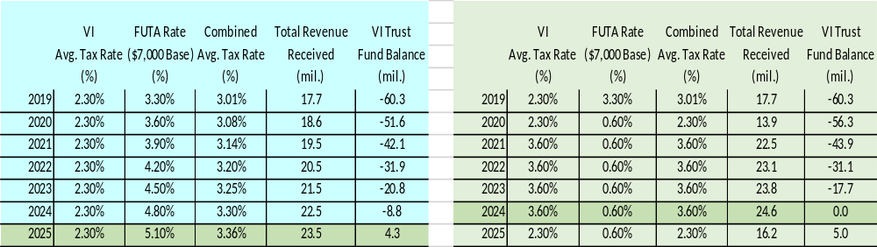
Forecast under new system
Assumption:
Current System Forecast
New Tax System Forecast

Slide 25
Distribution of Contribution Rates
Contribution Interval | Percentage of Employers’ Wages | Contribution Rate
1 | 2% | 1.5%
2 | 3% | 1.7%
3 | 5% | 1.9%
4 | 20% | 2.1%
5 | 40% | 2.4%
6 | 20% | 2.6%
7 | 5% | 2.8%
8 | 2% | 3%
9 | 1% | 3.4%
10 | 1% | 3.8%
11 | .5% | 4.2%
12 | .4% | 4.6%
13 | .09% | 5%
14 | .01% | 5.4%

Slide 26
Thank you for your time
For further information please contact the Unemployment Insurance Division www.vidol.gov 340-776-3700

